Slide 1
School Explorer Data
By: Breanna Atwood, Will Chirciu, Amy Edwards, Jeffrey Moy, Julie Simms

Slide 2
Introduction
PASSNYC School Data set From Kaggle
1,272 schools + 158 variables

Slide 3
Literature Review
PASSNYC has identified that data on English Language Learners, Students with Disabilities, Students on Free/Reduced Lunch, and Students with Temporary Housing, have been good indicators of the types of schools facing declining graduation rates.
Statistics released by the Office of the New York City Comptroller
Overall, graduation rates increased from 93% to 97%
Lowest performing quantile decreased from 61% to 50%
Lowest Economic Needs Index quantile had a 51% graduation rate vs. the 96% graduation rate in the highest Economic Needs Index quantile
Graduation Disparities by Race
88% - Asian Students
83% - White Students
70% - Black Students
68% - Hispanic Students
References:
Diploma Disparities: High School Graduation Rates in New York City. (2016, September). Retrieved from https://comptroller.nyc.gov/wp-content/uploads/documents/Graduation_Rate_Brief.pdf. Colangelo, L. L. (2018, February 08). City graduation rates show 1.2% rise for HS students. Retrieved from https://www.amny.com/news/nyc-high-school-graduation-rates-1.16606103.

Slide 4
Methods/Research Question
CCA
deets
K-means → Logarithmic Regression → K-medoids
Partition schools into like groups for policy enactment
LDA
PCA
Model Building & Multiple Regression
Research Question: Considering Economic Needs Index is an extreme factor in the gap in graduation rates in NYC, can we develop a multiple regression model that would help us identify what variables are true predictors of Economic Needs Index?

Slide 5
Discussion + Results

Slide 6
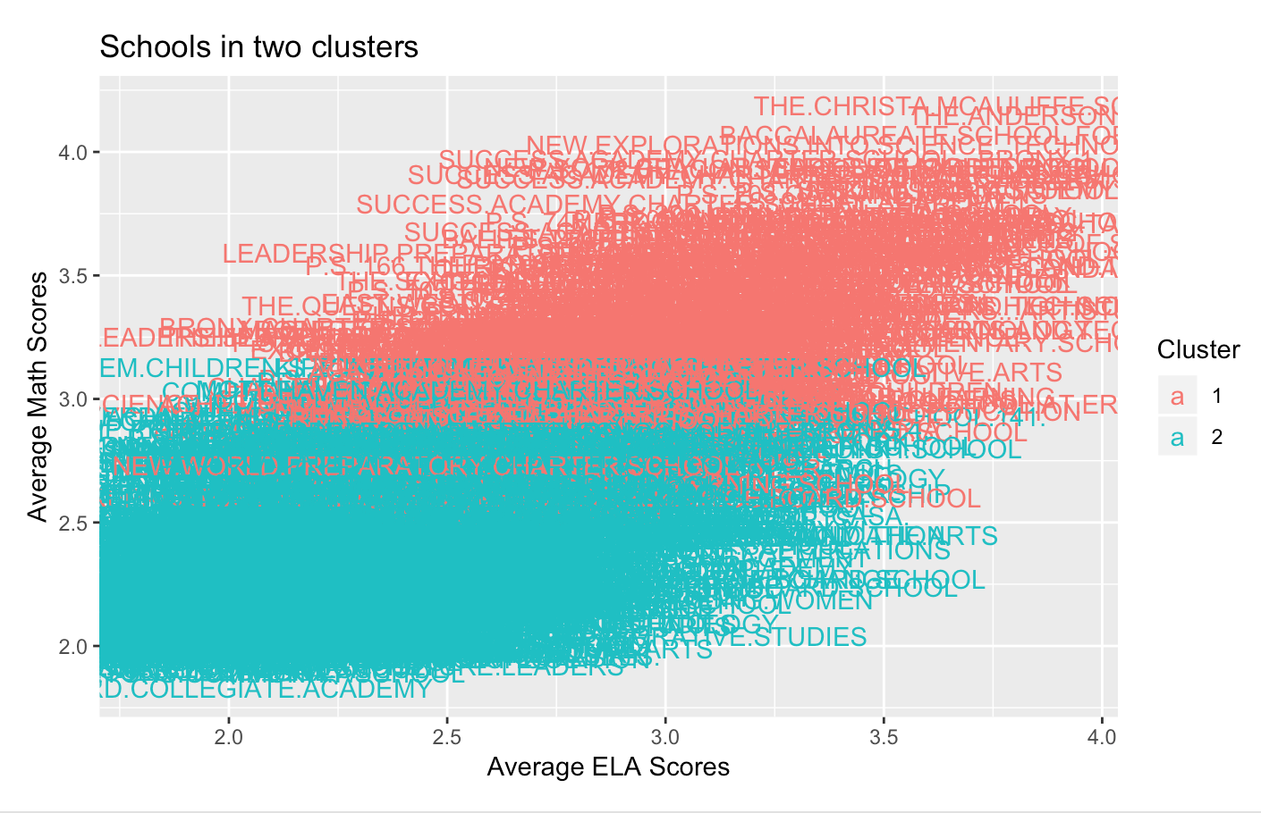
K-means → Logarithmic Regression → K-medoids
K-means: School Income Estimate, Avg Math Proficiency, Avg ELA Proficiency
Log Regression: Strong Family Community Ties, Rigorous Instruction, Percent ELL, Percent White, Percent Hispanic, Percent Asian, Student Attendance Rate
Notes:
Almost the same as the original data set intention, but instead of helping schools get more students to take the test, I wanted to group the schools together for educational policy purposes. It’s unreasonable for the city of New York to make individual administrative changes on 1,272 schools. But with groupings of schools, they could make some broad changes.
First chose three variables that seemed to encompass the data broadly. - got two clusters
SIE - measured in dollars, estimated income of households in that school
AMP - Performance Levels = 1 (insufficient), 2 (partial but insufficient), 3 (sufficient), and 4 (more than sufficient) - reflect the extent to which students demonstrate the level of understanding expected at their grade level, based on the New York State P-12 Common Core Learning Standards
AELAP- ELA = English Language Arts
Then I wanted to understand the most influential variables that would get you into the low math low ELA cluster or the high math/high ELA cluster.

Slide 7
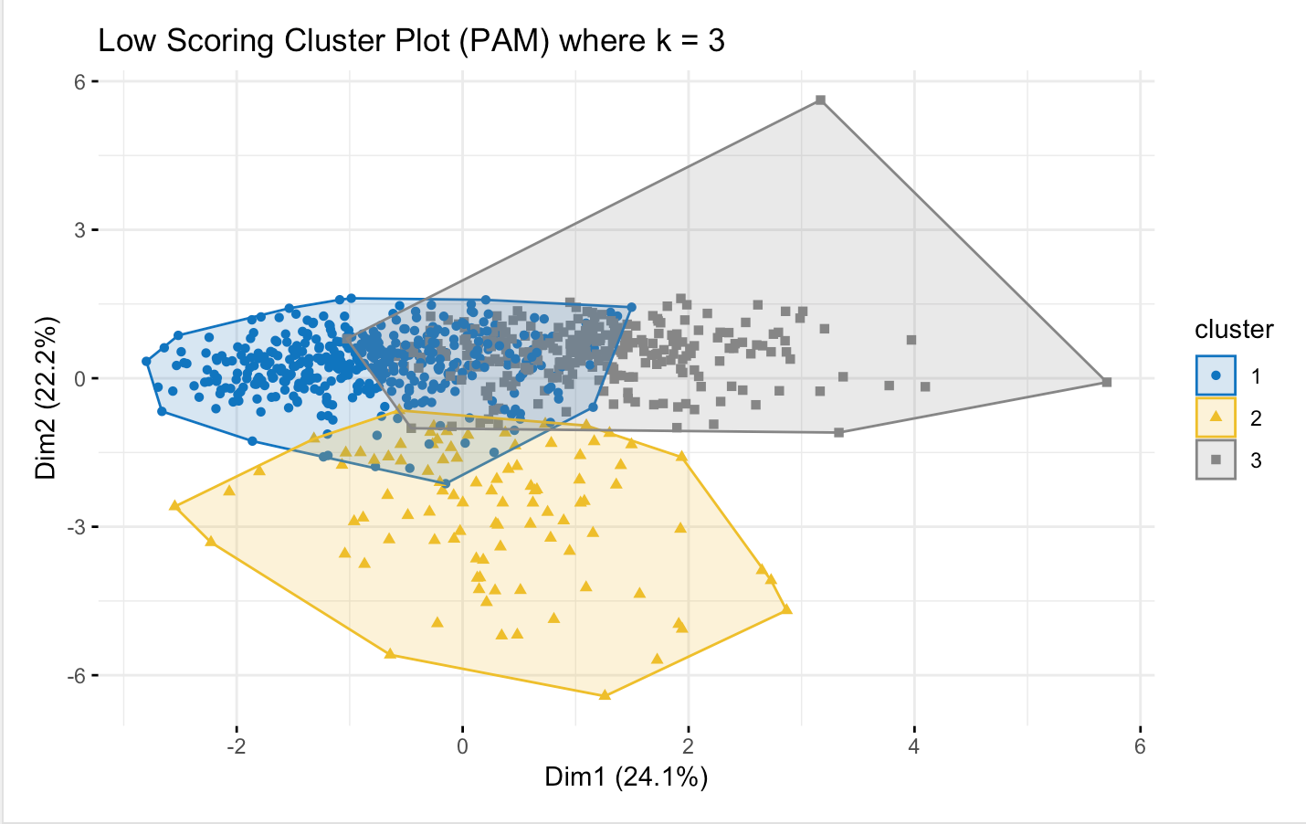
high
cluster 1: lowest percentages of ELL, Hispanic, Asian, and White students
cluster 2: very even distribution of demographics, higher percentage White
cluster 3: highest percent of Hispanic and ELL students.
Notes:
Only 46.3
Low math/ low ela broken up into 3 clusters

Slide 8
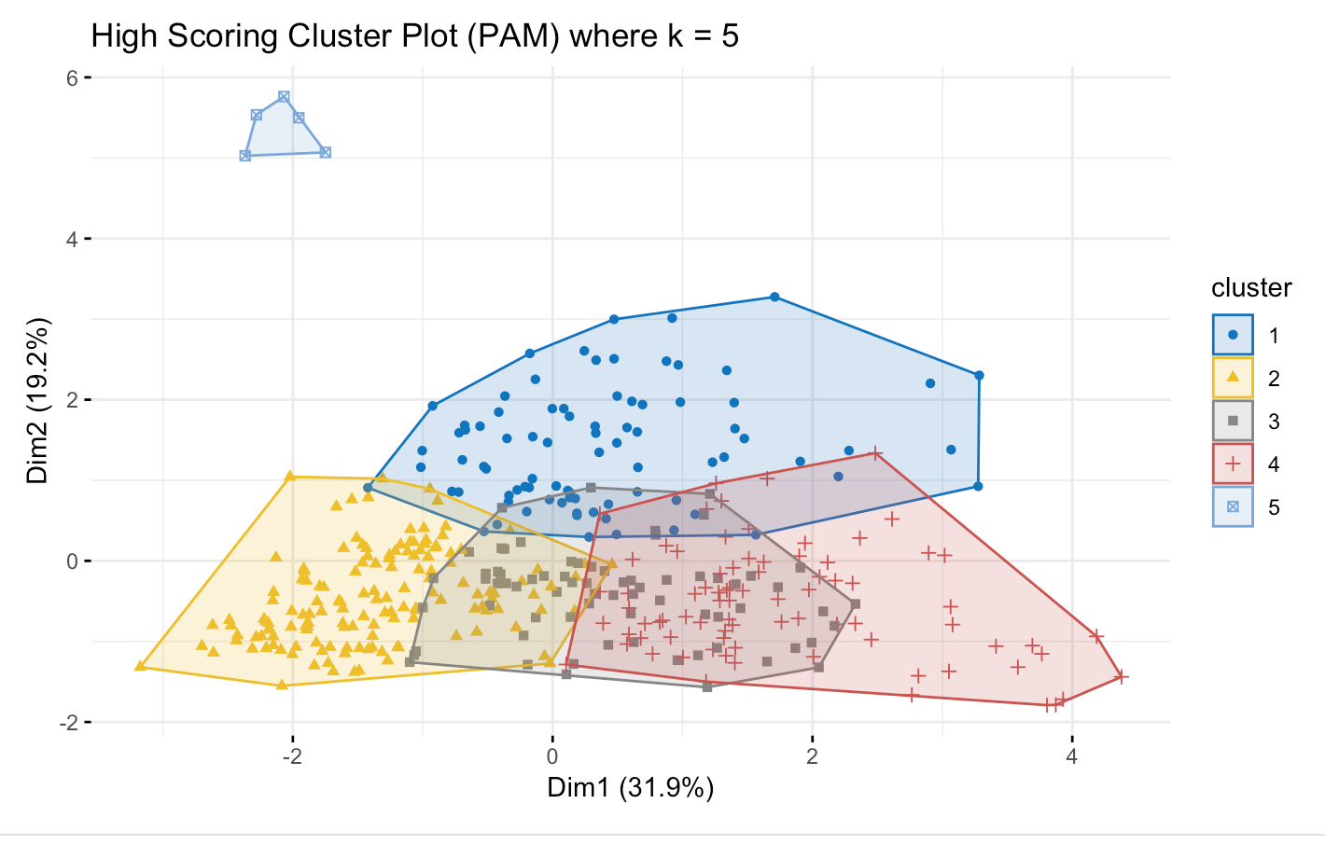
low
cluster 1: greatest percent of Hispanic students
cluster 2: highest percent of White students
cluster 3: highest score on Strong Family Community Ties and the lowest percent of ELL students
cluster 4: highest percent of Asian students
cluster 5: outliers / zero attendance
Notes:
51.1
High math/high ela broken up into 5 clusters
Conclusion: you could look at one school from each cluster

Slide 9
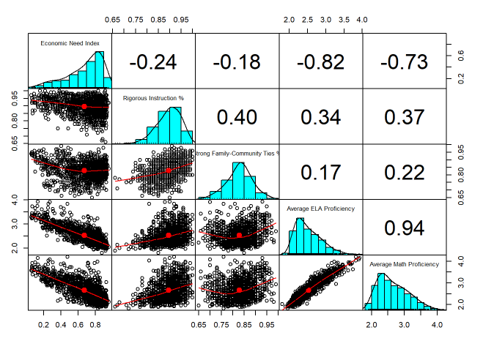

Linear Discriminant Analysis (LDA)
Predict Student Achievement Rating
Economic Need Index
Rigorous Instruction %
Strong Family-Community Ties %
Average ELA Proficiency
Average Math Proficiency
Examine the Data
Correlations
Histograms
Scatterplots

Slide 10
LDA Model Applied to Training Data
Prior Probabilities of Groups
Coefficients of Linear Discriminants
Approaching | Meeting | Exceeding | Not Meeting
0.25 | 0.54 | 0.20 | 0.00
 | LD1 | LD2 | LD3
Economic Need Index | -4.37 | -4.66 | -4.17
Rigorous Instruction % | -2.20 | 14.29 | -2.11
Strong Family-Community Ties % | 2.59 | -7.60 | 11.04
Average ELA Proficiency | -2.10 | -6.98 | 0.85
Average Math Proficiency | -2.44 | 3.44 | -1.45
Proportion of Trace
LD1 | LD2 | LD3
0.9857 | 0.0107 | 0.0036
The equation is -4.37 * Economic Need Index - 2.20 * Rigorous Instruction % + 2.59 * Strong Family-Community Ties % - 2.10 * Average ELA Proficiency - 2.44 * Average Math Proficiency.

Slide 11
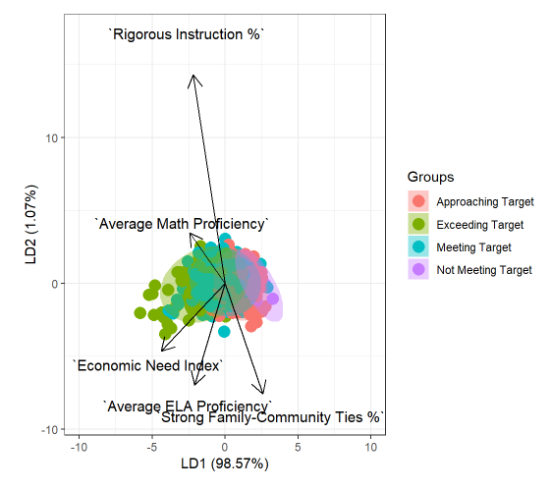
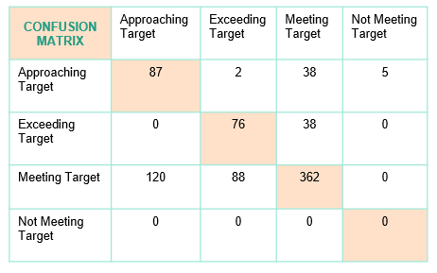
LDA Visualization and Accuracy
Bi-Plot
Accuracy
Training Data: The Confusion Matrix shows 64% accuracy.
Validation Data: The Confusion Matrix shows 64% accuracy.

Slide 12
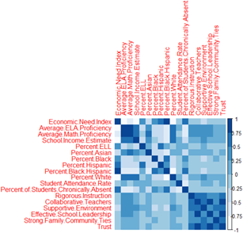
Model Building & Multiple Regression
Goal: Identify what predictors are significant in predicting the Economic Needs Index
Null Hypothesis: There are no variables, amongst those selected, that are significant predictors of Economic Needs Index.
Inputted Variables: Community school indicator, school income, % of students who are English Language Learners, race, school attendance rate, % of students chronically absent, rigorous instruction rating, collaborative teacher rating, supportive environment rating, effective school leadership rating, strong family-community ties rating, trust rating, average English Language Arts performance rating, and average Math performance rating

Slide 13
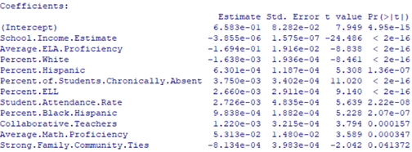
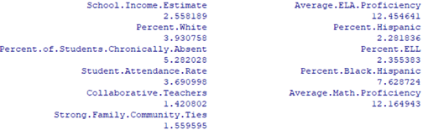
Model Building & Multiple Regression
All variables presented by Stepwise model are significant based on model
VIF scores indicate the need to investigate multicollinearity further
Stepwise Selection Model + VIF Scores

Slide 14
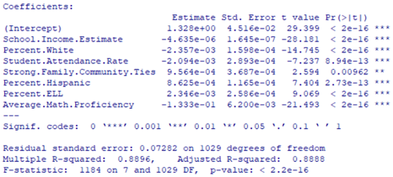

Model Building & Multiple Regression
Results:
Based on a p-value of <0.05, we can determine that the remaining variables are significant
Based on a VIF threshold of 4, we conclude there are no problems with multicollinearity
Limitations:
One year of results
~300 missing values
Future Work:
How can we use this predictors as a foundation for decreasing the Economic Needs Index?
Can we expand this analysis to identify commonalities across the country?

Slide 15
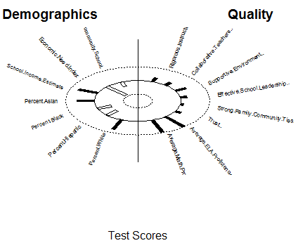

CCA : Test Scores
- ConCorr = 0.86
- X-vars: All variables except Community School
- Y-vars: Average Math/ELA Proficiency Scores
- Economic Need Index & Test Scores ‘--’ relation
- %Asian & Test Scores small ‘+’ relation

Slide 16
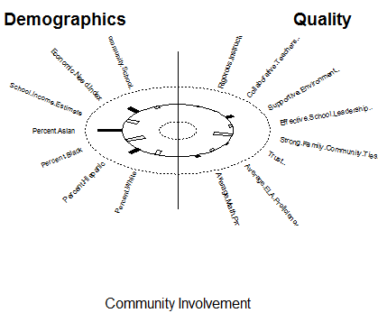


CCA: Family/Community Involvement
- ConCorr = 0.60
- X-vars: %Asian and %Black
- Y-vars: Strong Family/Community Ties
- %Asian and %Black have ‘--’ relation with Strong Family/Community Ties

Slide 17
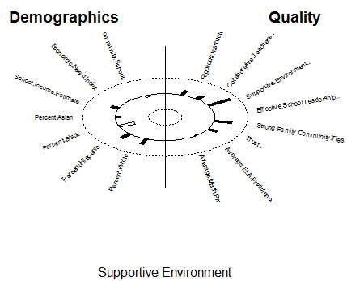
CCA: Supportive Environment
- ConCorr = 0.60
- X-vars: %Black
- Y-vars: Supportive Environment & Strong Family/Community Ties
- %Asian and %Black have ‘--’ relation with Strong Family/Community Ties

Slide 19
Future Work / Limitations
School income needs to be scaled based on the school. Larger schools need more money, school size isn’t part of data

